Slide 1

DS303 Project
By
Samar Agarwal - 21D070059
Madhav Gupta - 21D070043
Shivansh Gupta - 21D070067
Aaryan Sharma - 210110003
Image Classification
Using Convolutional Neural Networks

Slide 2


Research Paper used
Ajala, Sunday. (2021). Convolutional Neural Network Implementation for Image Classification using CIFAR-10 Dataset. 10.13140/RG.2.2.27690.54724.
While capable of image classification, traditional neural networks are characterized by feature extraction, a time-consuming process that leads to poor generalization on test data. This paper demonstrates how to classify CIFAR-10 datasets using a convolutional neural network (CNN). Previous research has demonstrated that this strategy can enhance performance without relying on feature extraction. To extract underlying image features, learnable filters and pooling layers were used. To avoid overfitting and provide better accuracies during validation and testing, dropout, regularization, and variation in convolution methods were used. This deeper network resulted in improved test accuracy and less overfitting.

Slide 3

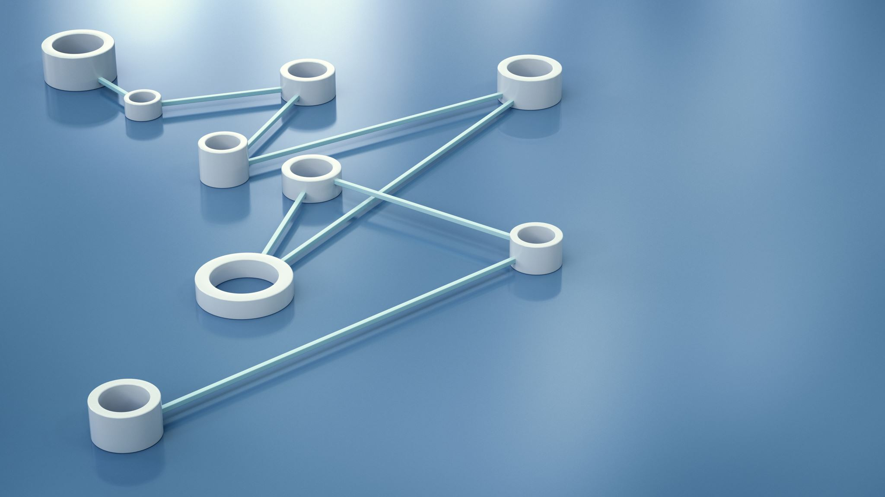
INTRODUCTION
We have studied and implemented a Research paper on Image Classification using CNN methods
To improve accuracy multiple layers including Convolution, maxpooling, dense, dropout were added to deepen the network
Overfitting is a main issue which need to be addressed either by reducing the model complexity or by increasing training dataset

Slide 4
Theoretical Background
Neural networks are a subset of machine learning that are modeled after the structure and function of the human brain, and are used for tasks such as image and speech recognition, natural language processing, and predictive modeling.
One key advantage of CNNs is that they are able to learn features directly from the data, without the need for manual feature engineering.
Training a neural network involves adjusting the weights and biases of the connections between neurons based on the error between the predicted output and the actual output, in a process called backpropagation.
CNNs have been shown to be very effective at tasks such as image classification, object detection, and segmentation
Machine learning involves the use of statistical algorithms and models to enable computers to learn from data and make predictions or decisions without being explicitly programmed.

Slide 5

Working of CNN algorithm
Input layer: The input layer of a CNN receives the raw image data as input. It is usually a rectangular grid of pixels, where each pixel represents a single value of intensity or color.
Fully connected layer: The fully connected layer is a traditional neural network layer, which takes the flattened output from the previous layers as input and produces a final classification output. It is responsible for making the final decision about the class of the input image.
Backpropagation: The backpropagation algorithm is used to train the CNN. It involves computing the gradients of the loss function with respect to the parameters of the network and using them to update the parameters via stochastic gradient descent.
Pooling layer: The pooling layer is used to downsample the feature maps obtained from the convolutional layer. It helps to reduce the spatial size of the feature maps while preserving their important features.
Convolutional layer: The convolutional layer is responsible for extracting features from the input image. It consists of a set of learnable filters, which convolve over the input image to produce a set of feature maps.

Slide 6
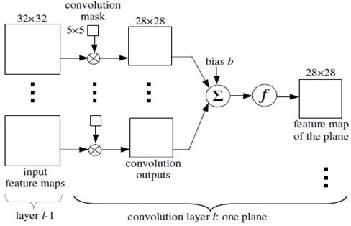
Convolution Layer
It applies a set of filters (also known as kernels or weights) to the input data.
Each filter convolves with the input data to produce a feature map capturing the presence of specific features in the input data.
Convolutional layer reduces the dimensionality of the input data while retaining its essential features.
The size of the filters used in the convolutional layer, the number of filters, and the stride length are some of the hyperparameters that affect the behavior of the convolutional layer.

Slide 7
The Image Classification Datasets used
Cifar-10 Dataset
UC Merced Land Use Dataset

Slide 8


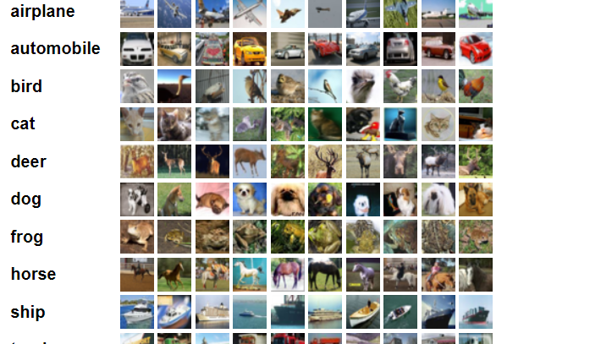
CIFAR-10 Dataset
The CIFAR-10 dataset consists of 60000 32x32 color images in 10 classes, with 6000 images per class. There are 50000 training images and 10000 test images.

Slide 9
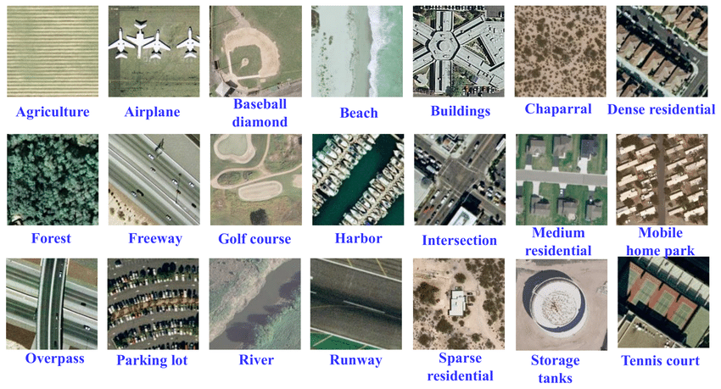
UC Merced Land Use Dataset
This is a 21 class land use image dataset meant for research purposes. There are 100 images for each of the following classes. Each image measures 256x256 pixels.
Yi Yang and Shawn Newsam, "Bag-Of-Visual-Words and Spatial Extensions for Land-Use Classification," ACM SIGSPATIAL International Conference on Advances in Geographic Information Systems (ACM GIS), 2010.

Slide 10

Dataset Pre-Processing
Classified all the classes into categories to be trained by merging classes of same categories and removing unused classes .
Splitting the dataset into training, validation, and testing sets.
Increased the diversity of the training dataset by applying various transformations such as rotation, scaling, flipping, etc.
Applying one hot encoding for labelling each category so that CNN can be used with a fully connected SoftMax layer to predict the categories of the images

Slide 11
Dataset Pre-Processing
Since the images from data sets are larger, size was reduced to decrease the model complexity
Incase training dataset was not enough, to prevent overfitting, we increased training dataset using image augmentation.

Slide 12

Network training and testing
The purpose of training algorithm as in is to train a network such that the error is minimized between the network output and the desired output
The error is reduced by minimizing a loss function. Loss function is a function of weights and biases and gets updated based on changes in them after various iterations
Different CNN networks were tested on two datasets, in turn each dataset is tested for different number of iterations for tuning
To prevent overfitting, number of epochs were maximized until the training and validation losses start diverging

Slide 13
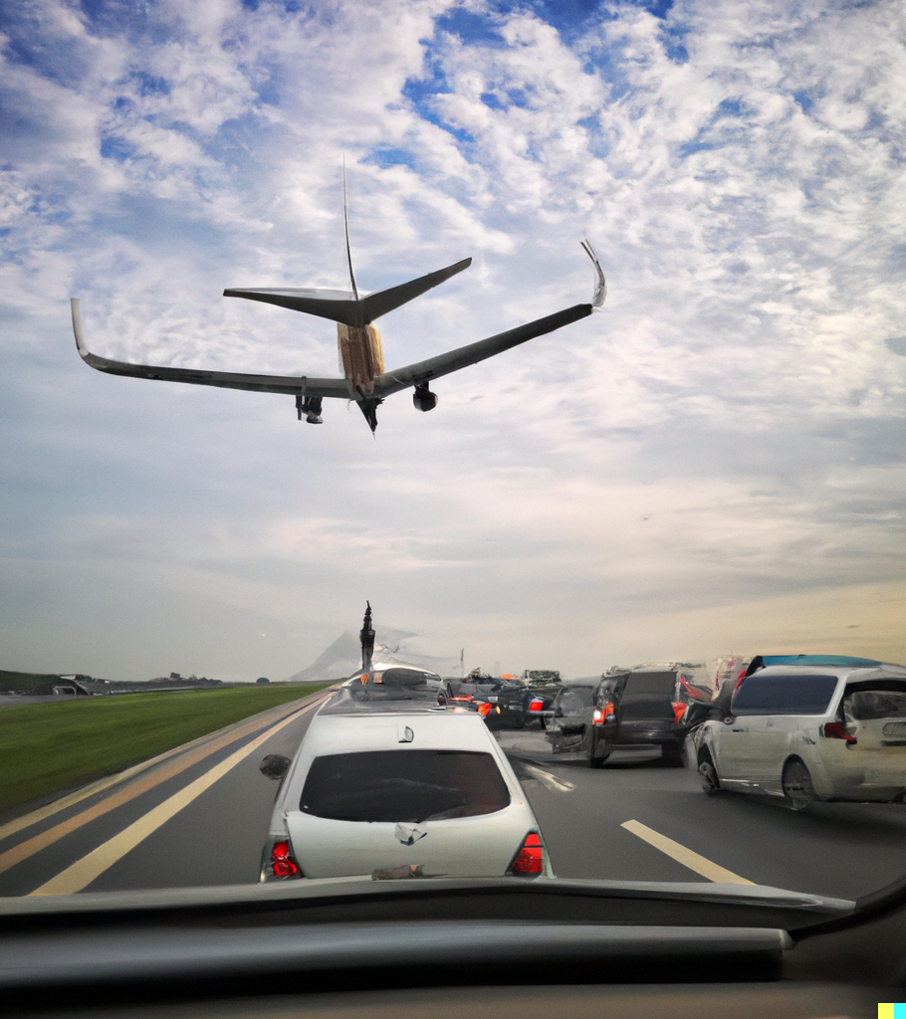
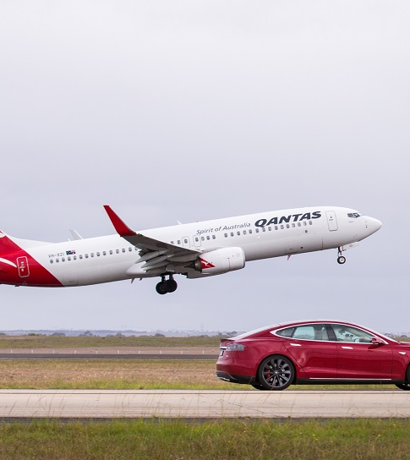
Airplane vs Automobile Image Classification
Training Accuracy | Test Accuracy
97.17% | 94.65%

Slide 14
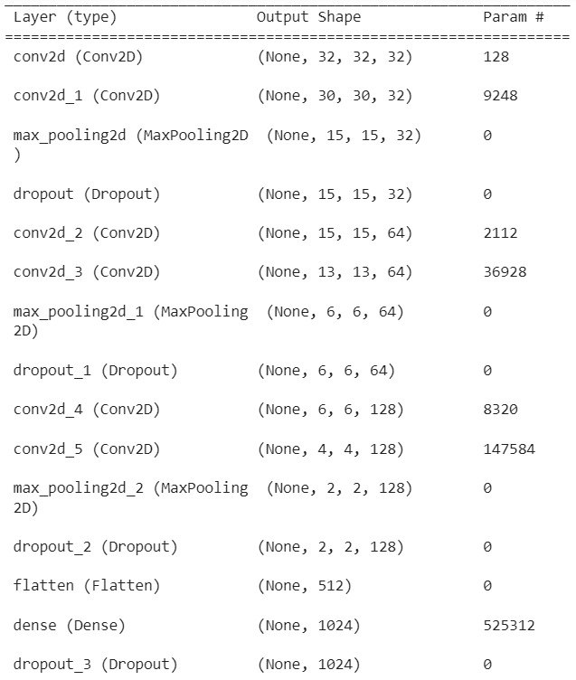
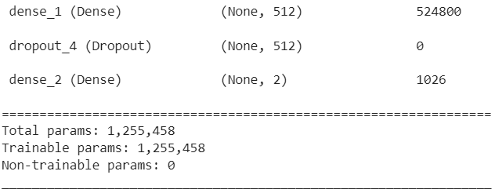
Model Summary

Slide 15

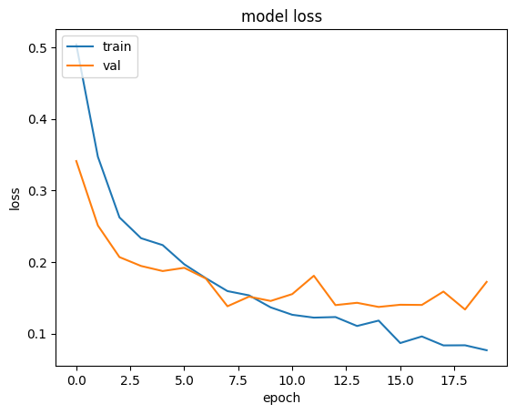
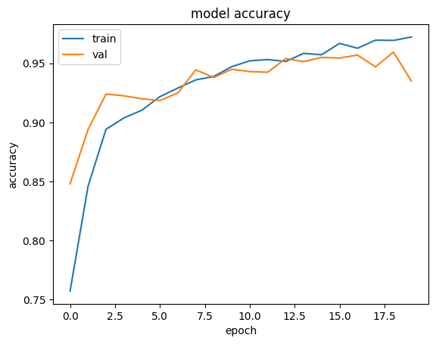
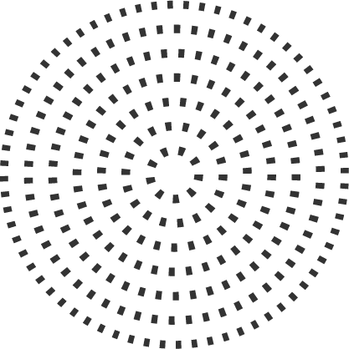
Losses and accuracies on training and validation data varying with number of epochs

Slide 16
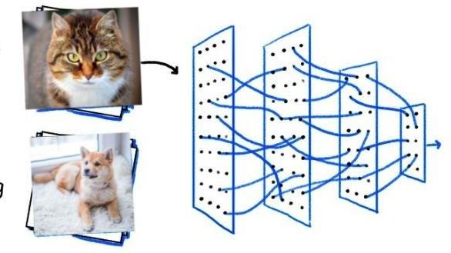
CAT vs DOG Classification
Training Accuracy | Test Accuracy
81.47% | 76.95%

Slide 17
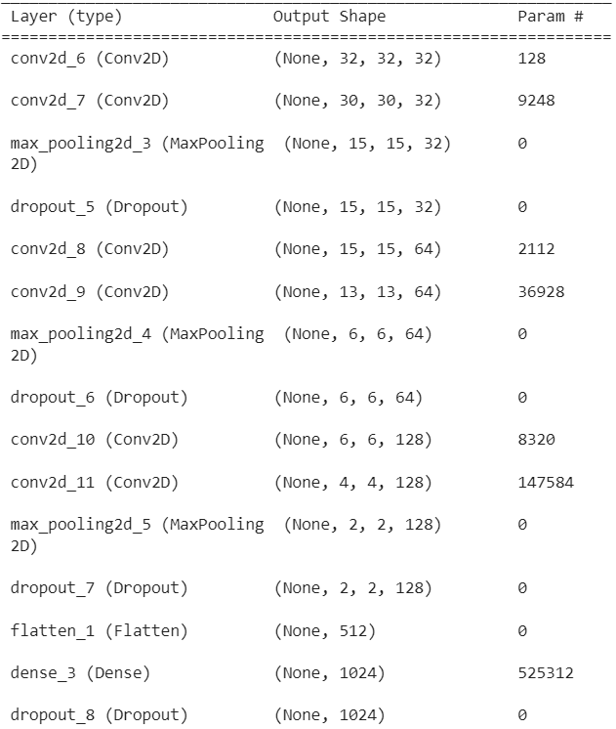
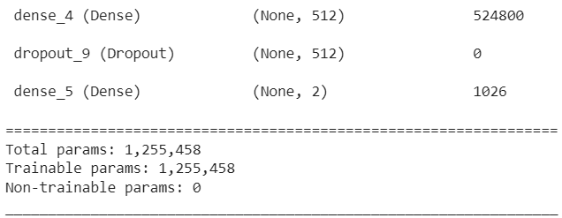
Model Summary

Slide 18
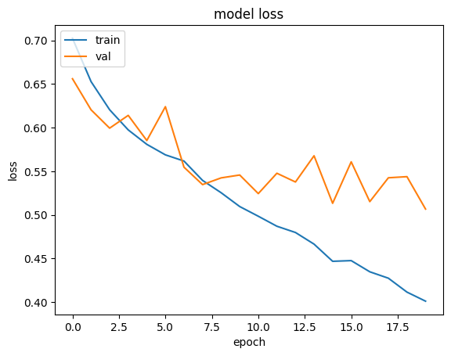
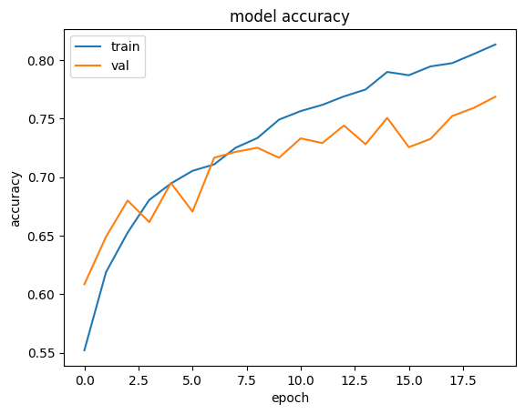
Losses and accuracies on training and validation data varying with number of epochs

Slide 19
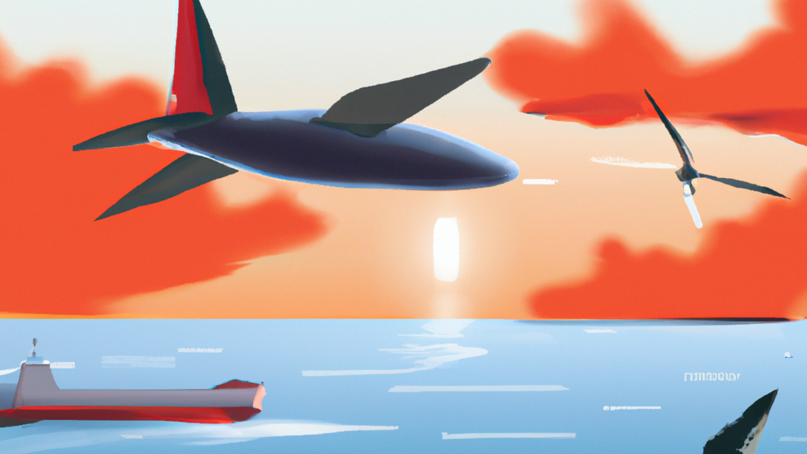
Bird vs. Airplane vs. Ship
Training Accuracy | Test Accuracy
89% | 86.90%

Slide 20
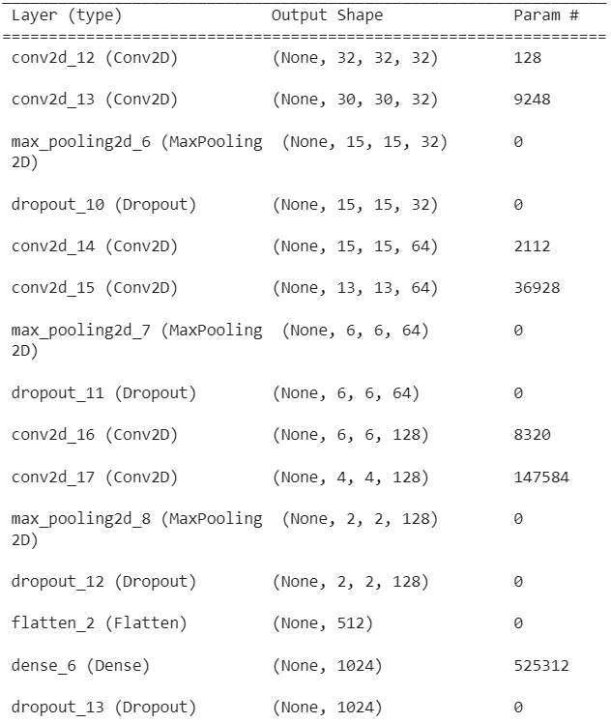
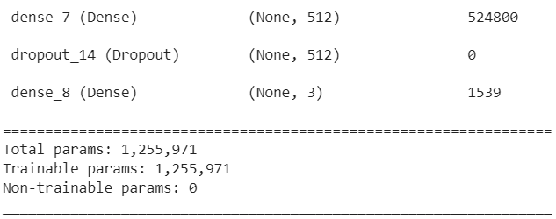
Model Summary

Slide 21
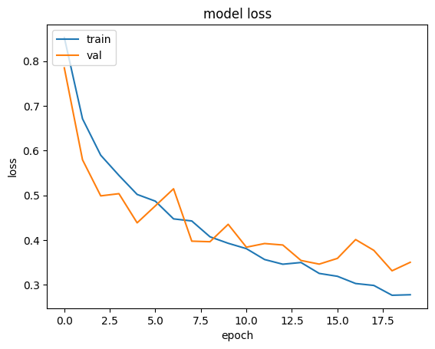
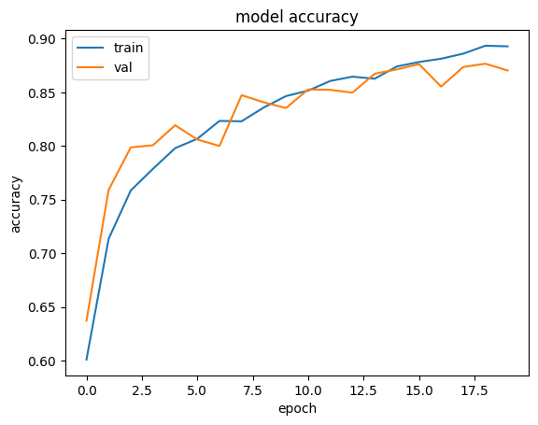
Losses and accuracies on training and validation data varying with number of epochs

Slide 22
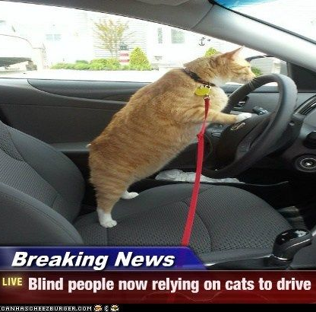
Animal vs. Vehicle
We classified all the classes into 2 categories Animal - Bird, Cat, Deer, Frog, Dog, Horse Vehicle – Automobile, Airplane, Ship, Truck
Training Accuracy | Test Accuracy
95.45% | 94.48%

Slide 23
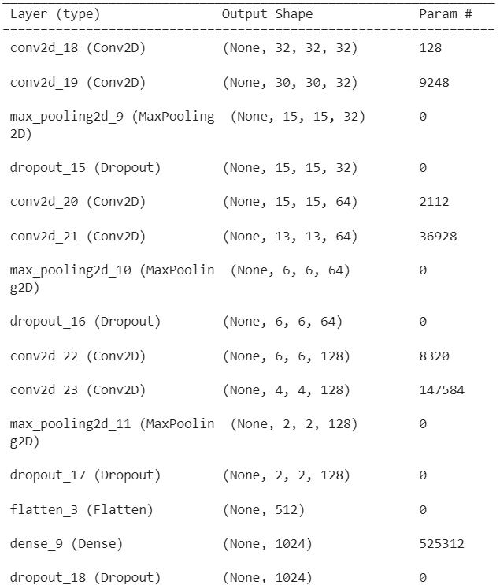
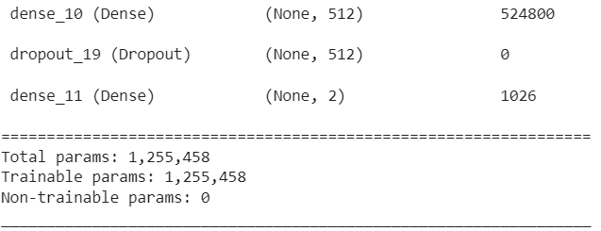
Model Summary

Slide 24
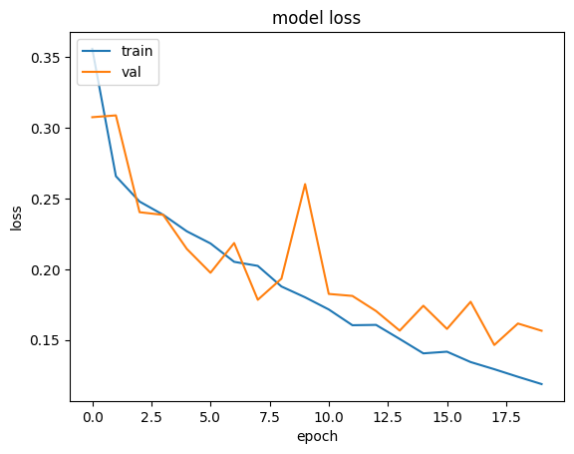
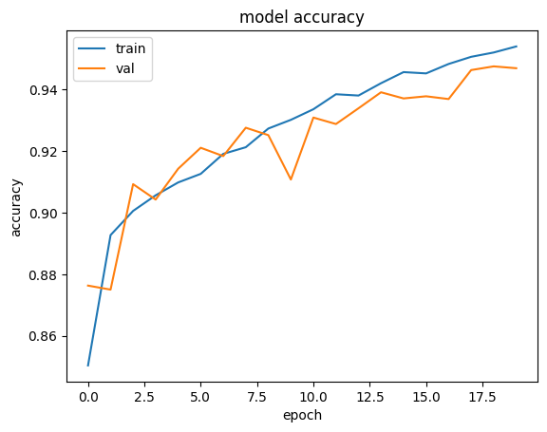
Losses and accuracies on training and validation data varying with number of epochs

Slide 25
RESULTS AND DISCUSSION
Plotted 2 graphs to choose appropriate epochs and prevent overfitting of data Training and validation accuracies vs. epochs Training and validation losses vs. epochs
We used categorical cross- entropy loss as a criteria to measure model accuracy and trained the model with 128 batch size and different number of epochs depending upon the performance
Displayed the actual and the predicted label of a few test images to visually compare the results

Slide 26
Classification on UC Merced Dataset
The number of images in this dataset were less compared to what is required for a good model training. (21 classes and 100 images per class)
So, to increase number of images for training and testing we used image augmentation method. By this we were able to increase our test data by fourfold.
For 100 epoch, on 9 classes, we got train accuracy = 90% and Validation accuracy = 85.24%
Loss function used is Cross Entropy Loss with Optimizer as ADAM
Training Accuracy | Test Accuracy
0.9000 | 0.8524

Slide 27
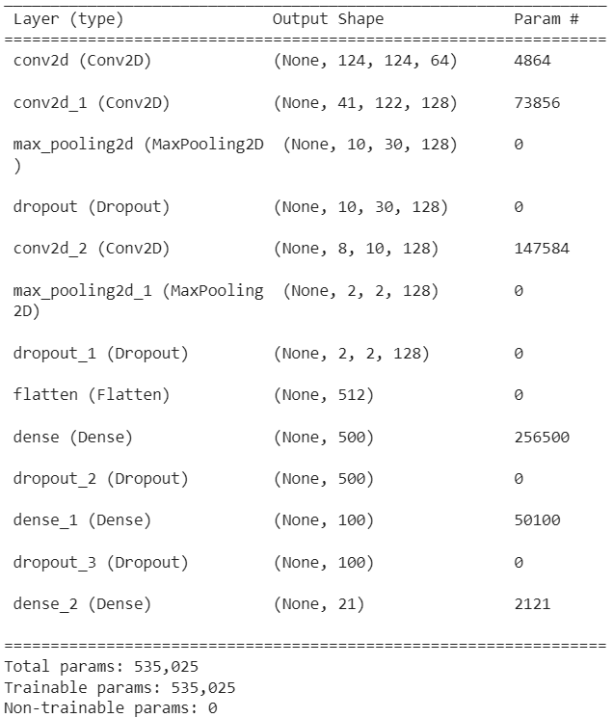
Model Summary

Slide 28
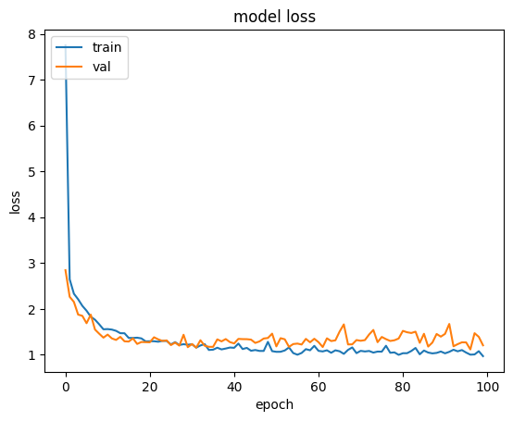
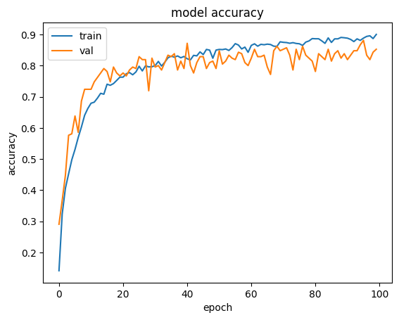
Losses and accuracies on training and validation data varying with number of epochs

Slide 29
Team Workload Distribution
Madhav Gupta 21D070043
Designed and Trained the CNN model for the Cifar-10 Dataset for various types of classification
Compiled the results of the final model and prepared the ppt content for Cifar-10 Dataset
Samar Agarwal 21D070059
Trained a preliminary model for multi-categorical classification on UC Merced Dataset
Designed and finalized the presentation to include the elementary slides like this one.
Shivansh Gupta 21D070067
Trained the final model for UC Merced Dataset using the increased training dataset
Aaryan Sharma 210110003
Performed Image augmentation on training dataset of UC Merced dataset
Researched on different types of Research papers on Image classification using deep CNN
Prepared the ppt content and results for the category classification on UC Merced Dataset
Resolved the issue of low image size in Cifar-10 dataset by using UC Merced and SUN397 so that we can have more input data per image.
The SUN397 dataset was hard to extract as it is a 40Gb dataset containing a way more classes than we expected so we used other dataset

Slide 30
REFERENCES
https://www.researchgate.net/publication/337240963_Convolutional_Neural_Network_for_CIFAR-10_Dataset_Image_Classification
Learning Multiple Layers of Features from Tiny Images, Alex Krizhevsky, 2009
(PDF) Convolutional Neural Network Implementation for Image Classification using CIFAR-10 Dataset (researchgate.net)
Image Classification Using Convolutional Neural Networks
Yi Yang and Shawn Newsam, "Bag-Of-Visual-Words and Spatial Extensions for Land-Use Classification," ACM SIGSPATIAL International Conference on Advances in Geographic Information Systems (ACM GIS), 2010 (for UCMerced Dataset)

